Slide 1

Creative Writing Competition
An Extraordinary Day
in the Life of my Favourite Literary Character
Secondary (I Grado)

Slide 2
Lesson Contents
Brainstorm your favourite characters
Choose one favourite, and present reasons why they are interesting
Look at ‘Story Arcs’ and what happens during the different stages
Work in groups to write part of your story
Assemble the Class Story
Wrap-up

Slide 3
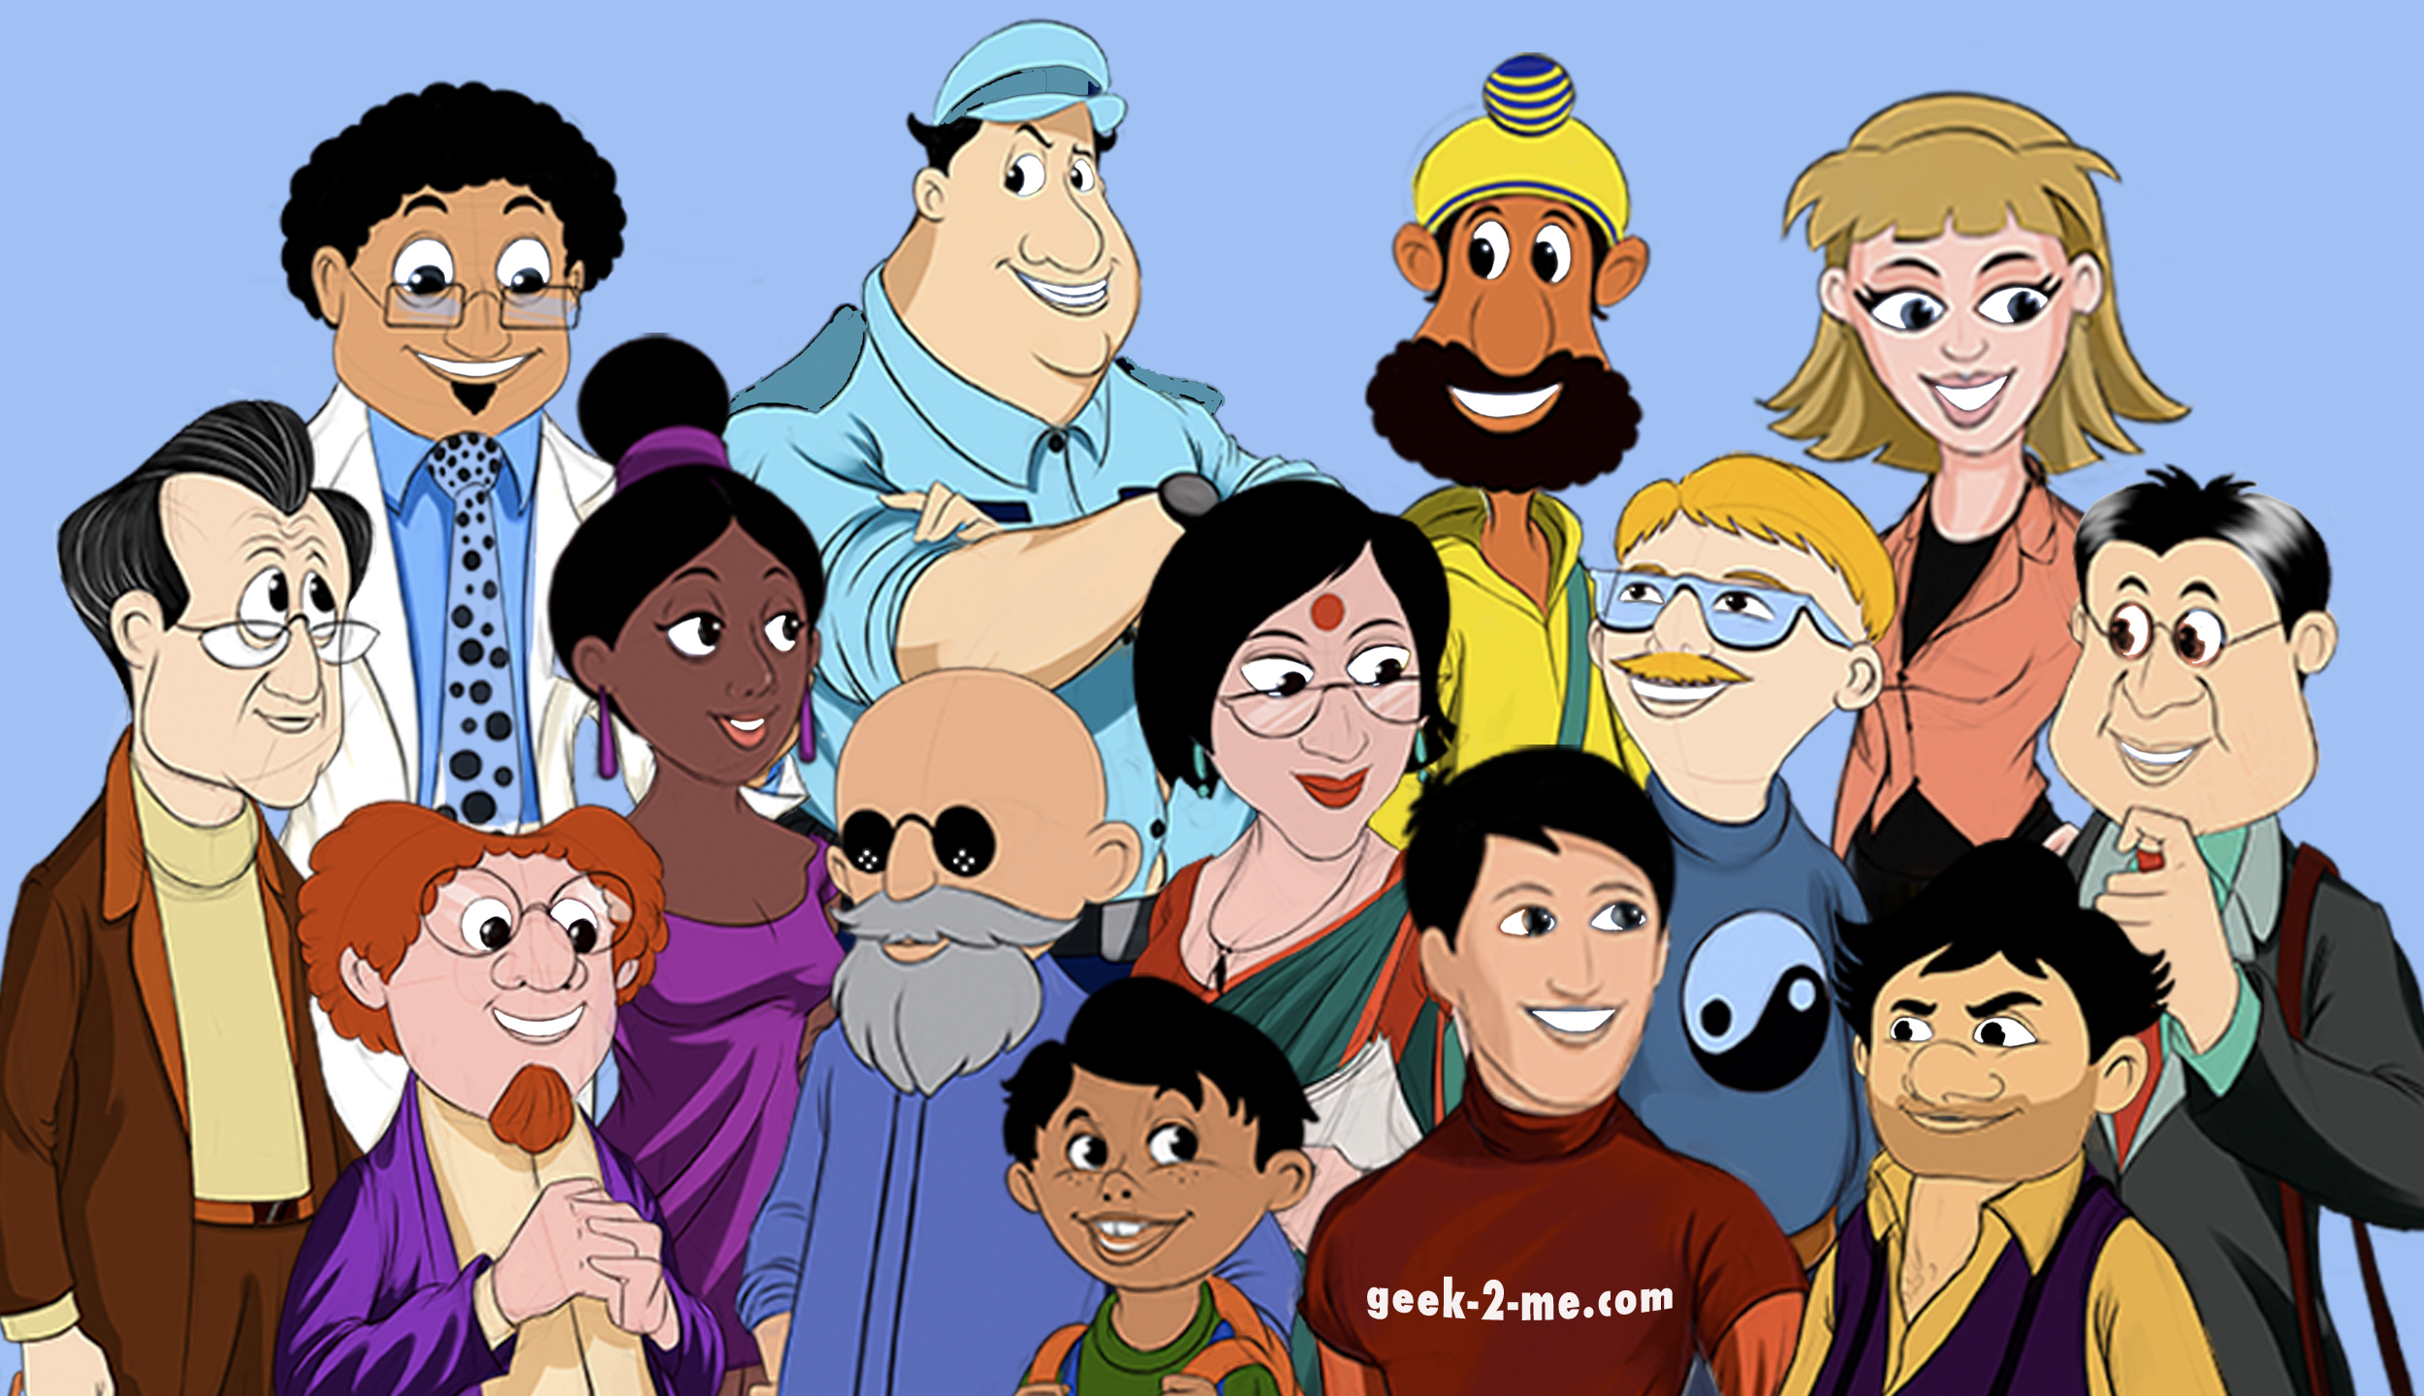
Warm up
Who’s your favourite character from a book, movie, or story?
Why?
This Photo by Unknown Author is licensed under CC BY-SA

Slide 4
Choose a Literary Character
Work in groups of 3 or 4.
Choose your favourite character.
Present your choice to the class and say why this character would be interesting.
Vote on the best character!

Slide 5
Story Arc
The most exciting or important moment in the story.
Exciting things begin to happen. The character faces problems or challenges.
Climax
The story starts to calm down and problems are being solved.
We meet the characters and learn about their world.
Rising Action
Falling Action
The ending of the story where everything is wrapped up.
Exposition
Resolution

Slide 6
Collaborative Writing Task
In your groups write your part of the story from the story arc
Include at least one piece of dialogue and descriptive language
Word limit: 50-70 words per part.
Sentence starters:
“In the morning, ( ) decided to….”
“( ) thought about….”

Slide 7
Assemble the Class Story
Read your part aloud to the class
As a class, discuss anything you want to change
Make sure the story flows well
One student writes the final version

Slide 8


Wrap Up
Read your story to the class.
Type your part of the story, use Arial Font Size 12
Well done!
Great job!

Slide 9
Homework. Write a story. Include 250-300 words.
'An Extraordinary Day in the Life of my Favourite Literary Character'
Make a list of your favourite characters from books.​
Choose one and think about why they are interesting.​
Plan your story. It should contain these 'Story Arc' aspects: ​
Exposition – We meet the characters and learn about their world.​
Rising action - Exciting things begin to happen and the character faces
problems or challenges.​
Climax - The most exciting or important moment in the story.​
Falling Action - The story starts to calm down and problems are being solved.​
Resolution - The ending of the story where everything is wrapped up​
Write a draft of your story for each part of the Story Arc above​
Check your draft for errors (spelling, grammar, repetition, punctuation)​
Type your complete story in Arial font size 12. Send to or print a copy for your teacher.

Slide 10

Enter the Competition
Deadline for entries: 17:00 on 17 March
One entry per class, submitted to: Lazio_competition@britishcouncil.org
Good Luck!

