Slide 1
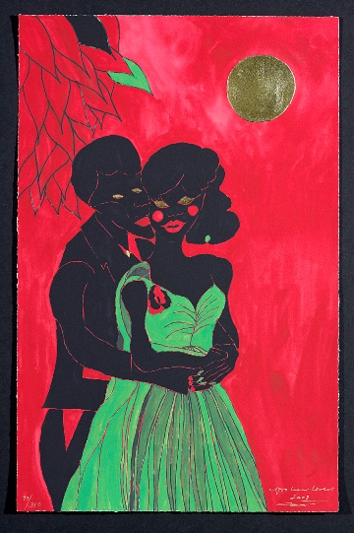
ARTiculation Talking about inspiring art WHY I LOVE THIS WORK OF ART
Chris Ofili , Afro lunar lovers I
Notes:
Why I love this work of art
(Artwork ref: Ofili Chris-P7834 Afro lunar lovers I)
Aim:
Generate interest
Explore reasons for the appeal of a work
Emphasise from the very beginning that THEIR views and feelings are paramount.
Activity
The teacher gives a 5 to 10 minute presentation on a work of art they love (having looked at the material in the four different sections). We suggest you change the image in the powerpoint to the work of art you love.
Instructions:
Students listen and make notes for as many reasons as they understand. Then using their notes ask follow up questions for more detail or clarification.
Students then choose a work they love (give plenty of thinking time) and explain why they love it to partners.
Class feedback of reasons given, use this as a first draft of reasons, used in Worksheet 1.
Material to hand out / show on screen
Give students Worksheet 1
“Why I love and chose this work”
To focus their listening on reasons which can form a reference for future use.

Slide 2
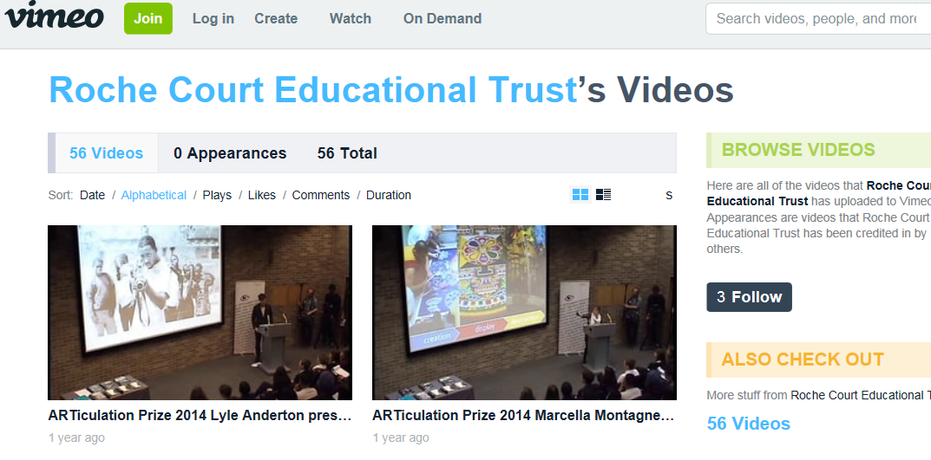
ARTiculation Talking about inspiring art WHY I CHOSE THIS WORK OF ART
Jodie Williamson on Hayao Miyazakis “Spirited Away” (00.00-01.5 ) https://vimeo.com/100880904
Zoe Lakota-Baldwin on Chris Ofili’s “The Upper Room” (00.00-00.41) https://vimeo.com/66234522
Antonia Osgood on Jeff Koons “Celebrate”: 00.00-01.51 https://vimeo.com/122621913
Molly Nickson on Henry Moore’s “Knife Edge: Standing Figure”(00.00-01.08) https://vimeo.com/63324687
Notes:
Explain reasons for choice of work
Image Ref. This is a screenshot from the Roche Court Educational Trust Vimeo playlist
Aim : To extend the language available to talk about reasons.
Material : Worksheet
Activity/ Instructions
Video extracts from Roche Court Vimeo playlist https://vimeo.com/rcet/videos/page:3/sort:alphabetical/format:thumbnail
First listening:
Watch four introductions and answer the question:
Why did they choose the work?
( Note all the speakers explain their choice within the first two minutes of their presentation).
Jodie Williamson on Hayao Miyazakis “spirited Away ( 00-1.52 ) https://vimeo.com/100880904
Zoe Lakota-Baldwin on Chris Ofili’s “The Upper Room” ( 00-00.41 ) https://vimeo.com/66234522
Antonia Osgood on Jeff Koons “Celebrate” (00-1.51) https://vimeo.com/122621913
Molly Nickson on Henry Moore’s “Knife Edge: Standing figure” ( 00-1.08 ) https://vimeo.com/63324687
TIP! Students listen without watching the video for the first time so they can focus on the language used.
Using the listenings
One: Students match the phrases on the worksheet 1 to the Roche presenter.
To make the exercise more challenging you could blank out the responses on the worksheet and ask students to extract the reasons and write them into the worksheet ( do one as an example).
Two: Elicit the student opinion of the presentations, positive and negative. This will lead into the next section “Criteria for evaluating a good presentation”.
It is important students keep some kind of record of these opinions and ways of expressing them as they will need them in section 4 where they are preparing their presentations.
Three: Give students the blank version of worksheet 2.
Suggested lead in: show students the images before they listen and ask them to speculate about why people chose them.
Suggested homework, students go to the Roche site and listen to a minimum of two other ARTiculation presentations and repeat the process of worksheet 2.

Slide 3
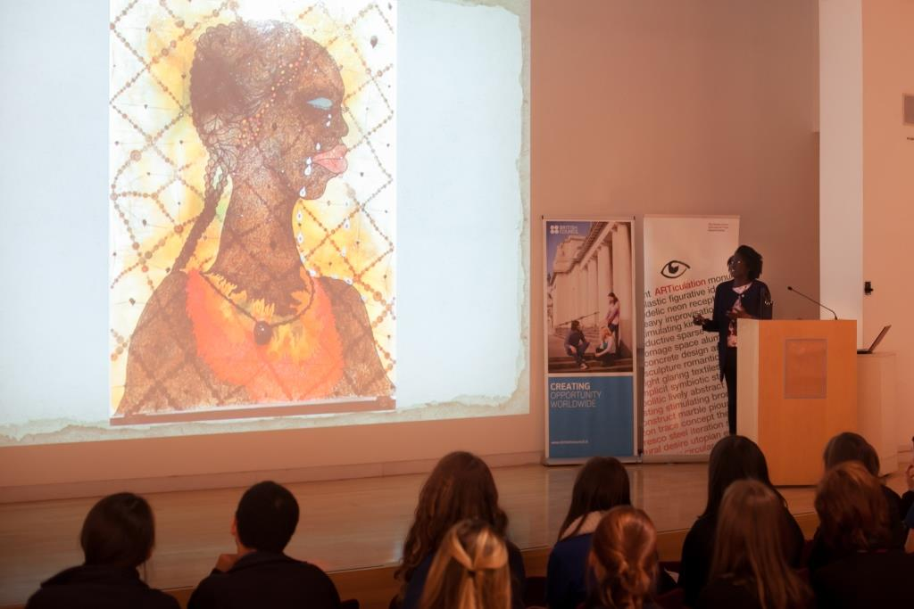
ARTiculation Talking about inspiring art WHAT MAKES A GOOD PRESENTATION?
Articulation Prize Italia, winner 2016
Notes:
What makes a good presentation?
Image ref: Photo taken at Articulation Prize Italia event at British School at Rome, March 2016 (image shows an artwork by Chris ofili)
Aim: To encourage students to explore features of a good presentation and begin to critically evaluate what they see. To start a checklist to be used later in their own evaluations.
Activity/Instructions
One: Ask students to draw up a checklist of what they think makes a good presentation. Suggest to them they consider the importance of impact at the beginning and different ways to open a presentation (you may need to show the introductions of the Roche speakers again).
Students’ comments and observations can be used/reformulated to draw up an initial checklist.
This checklist can be used to assess others and themselves.
A checklist should contain some of these elements but it is not prescriptive if you believe the students’ ideas are valid then include them. For reasons of space we have limited this to four on the worksheet.
How does the speaker engage with the audience? Do they get the audience attention (How?)? Are they easy to understand? Does the presentation flow well? Do they use humour, personal experience, stimulating visuals? Are there any idiosyncratic behaviours (ticks) that you notice?

Slide 4
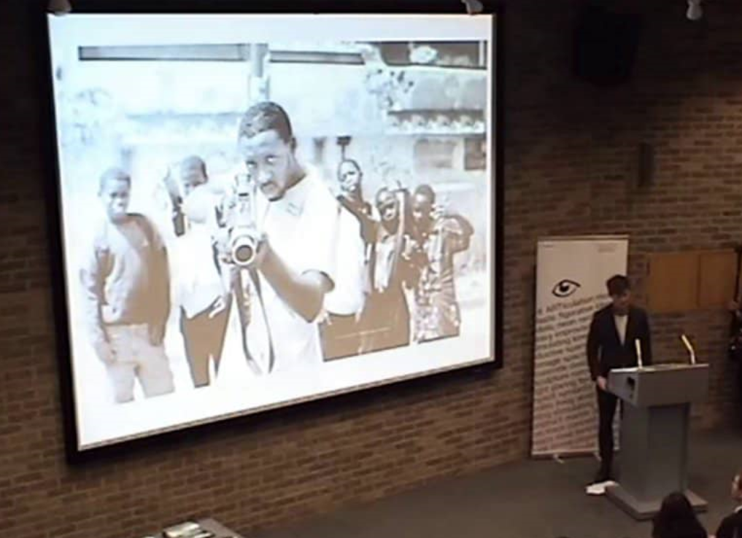
ARTiculation Talking about inspiring art WHAT MAKES A GOOD PRESENTATION?
Watch the introduction from Lyle’s presentation:https://vimeo.com/90105909
What were his reasons for choosing the work?
How do you evaluate his introduction according to the checklist drawn up?
What other techniques does he use?
Notes:
Explain reasons for choice of work contd.
Image Ref. This is a screenshot from the Roche Court Educational Trust Vimeo playlist
Aim: to encourage students to suggest and explore features of a good presentation
To start a checklist to be used later in course for evaluation purposes
Two: Watch the introduction from Lyle’s presentation: https://vimeo.com/90105909
What were his reasons for choosing this work?
Students use their evaluation checklist to analyse his introduction.
Did he use any techniques not previously mentioned? (Yes, direct questions to the audience).
Homework: Students look at the Roche presenters they selected in the previous homework and evaluate the introduction of their presentations using their checklists. They should also add some new ideas to their checklists based on what they have watched.

Slide 5
ARTiculation Talking about inspiring art BRITISH ARTISTS
Have you heard of any of the following artists?
Phyllida Barlow / Sarah Lucas / Helen Sear / Sonia Boyce / Ed Atkins Steve McQueen / Chris Ofili / Rachael Maclean / Mike Nelson / Tracey Emin / Mark Wallinger / Gary Hume / Rachel Whitread / Jeremy Deller / James Richards / Gilbert& George/ Matt Collishaw/ Karla Black Which ones have represented their country at the Venice Biennale?
Notes:
Contemporary British artists
(IMAGE REF: Artist Jeremy Dellar outside the British Pavilion in Venice, 2013)
Contemporary British artists
Aim: To introduce some contemporary artists, to explore reactions and reasons to recycle some of the language and ideas from previous work.
Activity /Instructions
Teacher asks students if they have heard of any of the British artists named on the slide and a conversation can develop if the students are familiar with the artists and their work. The question on the slide ”Which ones have represented their country at the Venice Biennale?” can be used to get the students to research the artists.
Students look at a selection of works by the artists (either the teacher prints out images in advance or if there is internet access asks students to research some of the artists).
One: Students look again at the artists’ work and decide if they like or dislike it, make notes in column 2 of worksheet 4.
Students look again and try to elaborate their reaction, articulating what appeals to them.
(Colour, theme, mood, space etc…).
Two: Students compare impressions, and then work in small groups to prepare a short presentation of the work of their choice, giving reasons for their selection.
This is an opportunity for the teacher to monitor and make notes on worksheet 4.1 to help the students with language errors or encourage more risk taking. This could be done in both One and Two.
At the end of the lesson the teacher should note the reactions of the student and note them in worksheet 4.2. These will be used to guide the student in their selection process. They will help build a profile of the type of art the student likes.
Homework:
Students investigate either individually or in small groups the artist(s) they liked. They can go to artists’ websites or google them for background information. Using worksheet 4 they should investigate their reactions and reasons for liking the artist.
Students investigate an artist they did not like and note their reactions and reasons.
These can form the basis of an in-class discussion and offers the teacher an opportunity to offer feedback based on their notes in worksheet 4.2. Student discussion and teacher feedback should stimulate a more critical view of student reactions and perhaps to open their minds!

Slide 6
ARTiculation Talking about inspiring art FOCUS ON ONE ARTIST
Rachel Maclean, Spite Your Face, 2017. Courtesy Scotland + Venice. Commissioned by Alchemy Film & Arts in partnership with Talbot Rice Gallery and the University of Edinburgh. Photo by Patrick Rafferty.
Notes:
Choose
(Image ref: Rachel Maclean, Spite Your Face, 2017. Courtesy Scotland + Venice. Commissioned by Alchemy Film & Arts in partnership with Talbot Rice Gallery and the University of Edinburgh. Photo by Patrick Rafferty)
This final section summarises the work of the students in this part and prepares them
for part 2 Describe which explores aspects of colour, space, media and theme.
Aim: One artist
Review reasons for choosing an artwork, preferably an artwork the student is passionate about!
Summarise the reasons as a lead in to part 2 Describe.
Introduce other reasons, those used in Describe (colour , space etc…).
Focus on presentation introductions.
Options:
1) Students present findings from homework research to class.
Class feedback can focus on ideas from worksheets 2 and 3 and the teacher’s notes (4.1 and 4.2).
2) Students present their findings in pairs or small groups. The teacher monitors and helps raise awareness of language problems/opportunities and guides the students towards the content of the next part.
Feedback Focus:
1) Presentation Introductions ( worksheet 3)
2) Language feedback (worksheet 4.1)
3) Feedback on ideas and preferences (worksheet 4.2)
By the end of this section students should have a clearer idea of why they like a work and the language they need to express their opinions.

